Slide 1


DSA LAB C++ PROJECT PRESENTATION
Inventory Management System Project
Presented By
Khandakar Borhan Uddin
ID: 0432310005101008
Section: 3B1
Optimizing Stock Control for Better Efficiency

Slide 2


C++ Inventory Management System Overview
This project aims to develop a robust inventory management system using C++. It focuses on efficiently handling product data, allowing users to add, update, and manage inventory with ease, which is crucial for businesses.

Slide 3



Motivation for C++ Inventory Management System
01
02
03
Real-world applications include efficient stock management for businesses of all sizes.
Learning goals focus on enhancing programming skills and understanding project workflows.
Hands-on experience with C++ reinforces problem-solving and algorithm development capabilities.

Slide 4
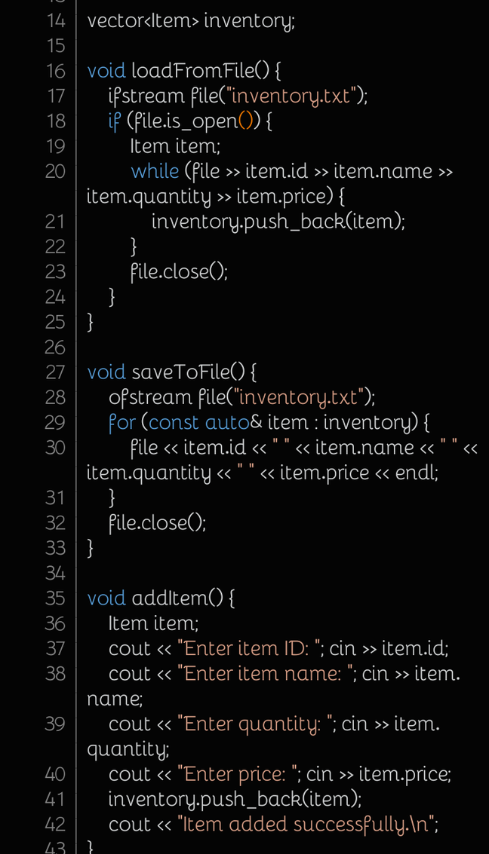
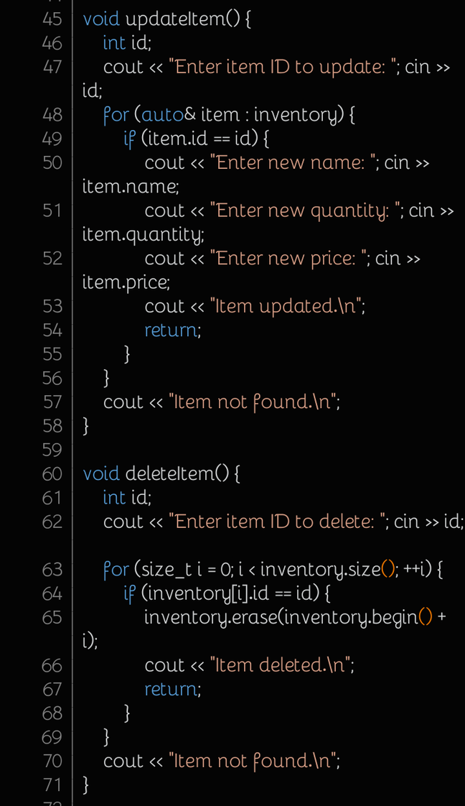

Tools and Technologies Used
Key components for successful project development
The project utilizes C++ as the primary programming language, along with an IDE such as Visual Studio for development. Essential libraries, including STL for data structures, facilitate efficient programming and enhance functionality, ensuring a robust inventory management system.

Slide 5
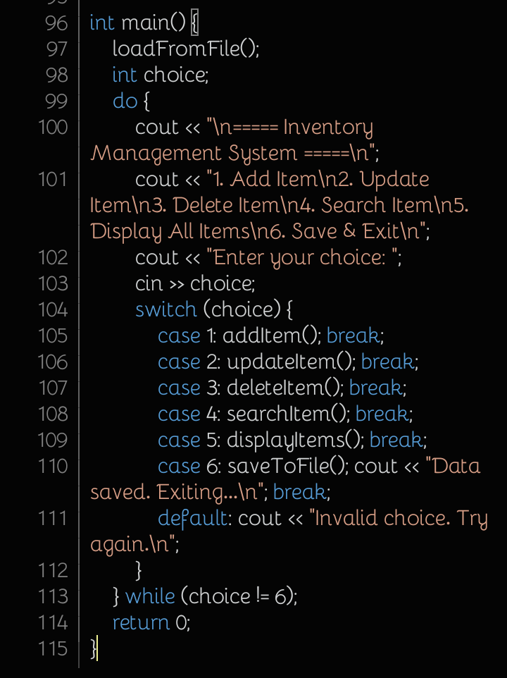

Key Features of the System
Add and Update Items
Easily add new items or update existing inventory details.
Overview of the functionalities implemented in the project
Delete Items
Remove items from the inventory with a simple command.
Search and Display
Quickly find and view item details for efficient management.

Slide 6
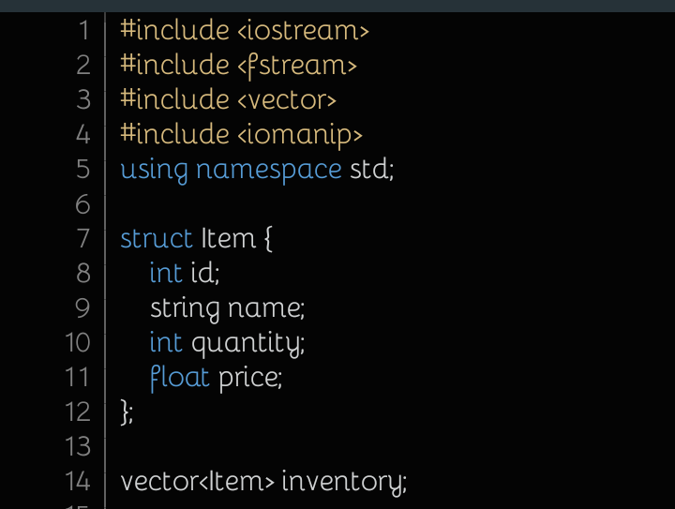
Understanding Structs and Vectors
Exploring data structures in C++ for inventory management
In our C++ Inventory Management System, we utilize structs to define item properties and vectors for dynamic item storage. This approach allows for efficient data handling, enabling operations such as adding, updating, and retrieving inventory items seamlessly.

Slide 7
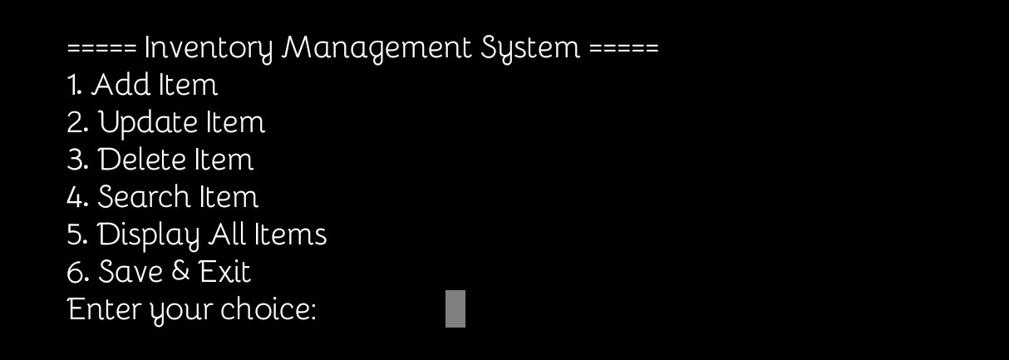
Sample Output from Inventory Management System
Demonstrating the key functionalities in action
The screenshots showcase the user interface of the C++ Inventory Management System. Key functionalities include adding, updating, and deleting items, as well as searching and displaying the inventory efficiently, providing a clear understanding of the system's usability and effectiveness.

Slide 8
Challenges Encountered During Development
Throughout the development process, we faced several significant challenges that tested our problem-solving skills. Addressing issues such as debugging, optimizing performance, and managing project scope were crucial in ensuring the system's functionality and reliability.

Slide 9
Future Enhancements for the System
Exploring potential improvements is crucial for maximizing efficiency and user experience. Enhancing features like automated reporting and a user-friendly interface can significantly boost productivity and make the system more adaptable to user needs.

Slide 10

Any questions or feedback?
We welcome your thoughts and insights on our project!

